Slide 1
Workshop: Gene expression data analysis
Mirella Flores Gonzalez (Boyce Thompson Institute)
Carolina Mazo-Molina Ph.D (Cornell University)
6/12/2021

Slide 2
Agenda
Introduction to Gene expression (Carolina Mazo)
What is it?
Which molecular techniques should I use?
How to design the gene expression experiments?
Demo differential gene expression (Mirella Flores)
edgeR

Slide 3
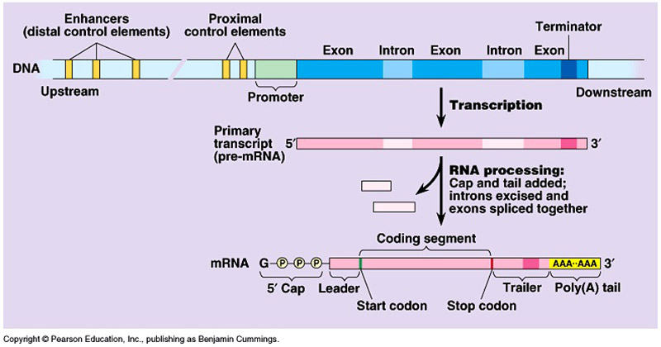
What is gene expression?
Transcription is the process by which the information in a strand of DNA is copied into a new molecule of RNA.
It is the first step of gene expression, in which a particular segment of DNA is copied into RNA (especially mRNA) by the enzyme RNA polymerase.
It results in a complementary, antiparallel RNA strand called a primary transcript.
Notes:
https://microbenotes.com/eukaryotic-transcription/

Slide 4
Which molecular biology techniques should I use?
Gene expression employ a wide variety of molecular biology techniques and experimental methods.
Gene expression analysis studies can be broadly divided into four areas:
RNA expression
Northern blotting
RNA-seq
Promoter analysis
Chromatin immunoprecipitation (ChIP)
Gel shift assays
Protein expression
Western blotting
Immunoassays
Post-translational modification
Mass spectrometry
Real-Time PCR (qPCR)
Notes:
Northern blotting — steady-state levels of mRNA are directly quantitated by electrophoresis and transfer to a membrane followed by incubation with specific probes. The RNA-probe complexes can be detected using a variety of different chemistries or radionuclide labeling. This relatively laborious technique was the first tool used to measure RNA levels
Real-Time PCR — steady-state levels of mRNA are quantitated by reverse transcription of the RNA to cDNA followed by quantitative PCR (qPCR) on the cDNA. The amount of each specific target is determined by measuring the increase in fluorescence signal from DNA-binding dyes or probes during successive rounds of enzyme-mediated amplification. This precise, versatile tool is used to investigate mutations (including insertions, deletions, and single-nucleotide polymorphisms (SNPs)), identify DNA modifications (such as methylation), confirm results from northern blotting or microarrays, and conduct gene expression profiling. Expression levels can be measured relative to other genes (relative quantification) or against a standard (absolute quantification). Real-time PCR is the gold standard in nucleic acid quantification because of its accuracy and sensitivity. Real-time PCR can be used to quantitate mRNA or miRNA expression following conversion to cDNA or to quantitate genomic DNA directly to investigate transcriptional activity
Gel shift assays — also called electrophoretic mobility shift assays, these are used to study protein-DNA or protein-RNA interactions. DNA or RNA fragments that are tightly associated with proteins (such as transcription factors) migrate more slowly in an agarose or polyacrylamide gel (showing a positional shift). Identifying the associated sequences provides insight into gene regulation
Chromatin immunoprecipitation (ChIP) — protein-binding regions of DNA can be identified in vivo. In living cells, DNA and protein are chemically cross-linked, and the resulting complex is precipitated by antibody-coated beads (immunoprecipitation). Following protein digestion and DNA purification, the sequences of the precipitated DNA are determined
Western blotting — quantification of relative expression levels for specific proteins is accomplished by electrophoretically separating extracted cell proteins, transferring them to a membrane, and then probing the bound proteins with antibodies (targeted to antigens of interest) that are subsequently detected using various chemistries or radiolabelling
Immunoassays — proteins are quantitated in solution using antibodies that are bound to color-coded beads (as in the Bio-Plex supension array system) or immobilized to a surface (ELISA), which is subsequently probed with an antibody suspension and is typically detected using a chromogenic or fluorogenic reporter
Mass spectrometry — proteins and their modifications are identified based on their mass

Slide 5
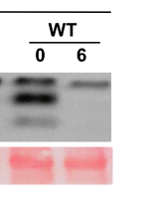
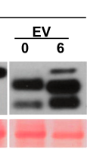
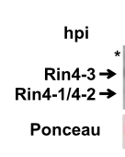
How to design the gene expression experiment? Western Blotting
Sample
Plant inoculated with a bacterium carrying a protein of interest or the empty vector
Protein electrophoresis (SDS-PAGE)
Protein extraction
Immunoblot
Transfer of the proteins from the gel to a membrane
Protein quantification
Sample preparation and gel run
Use antibodies specific to detect the protein of interest
Protein expression

Slide 6
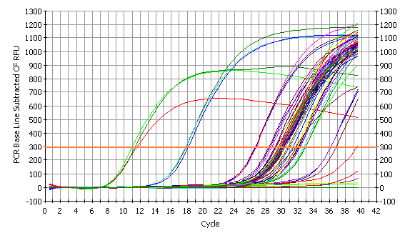
How to design the gene expression experiment? Quantitative Real-Time PCR
Sample
Plant inoculated with a bacterium or a blank solution to test the expression of a plant gene of interest
Sample preparation
RNA extraction using kit (RNeasy plant mini kit QUIAGEN)
qRT- PCR
Mix primers, cDNA and SYBR
DNAse digestion treatment
cDNA synthesis
Use at least 2 replicates for each sample.
Use a housekeeping gene (Ej: ARD2)
Amplification plots
Cycle threshold value (Ct)
Comparative Ct (ΔΔCт)
Notes:
What does Ct mean?
Real Time PCR Ct Values
In a real time PCR assay a positive reaction is detected by accumulation of a fluorescent signal. The Ct (cycle threshold) is defined as the number of cycles required for the fluorescent signal to cross the threshold (ie exceeds background level). Ct levels are inversely proportional to the amount of target nucleic acid in the sample (ie the lower the Ct level the greater the amount of target nucleic acid in the sample). WVDL real time assays undergo 40 cycles of amplification.

Slide 7
How to design the gene expression experiment? RNA-Seq
Sample
Plant inoculated with a bacterium or a blank solution to test the expression of a plant gene of interest
Sample preparation
RNA extraction using kit (RNeasy plant mini kit)
Library preparation
3’ RNA-seq libraries (Quantseq FWD kit )
Removal of adaptors and low-quality sequences using Trimmomatic
DNAse digestion (RNase-Free DNase Kit) treatment
Data processing
Alignment of clean reads to the SILVA rRNA database using BOWTIE
Alignment of final high-quality reads for each library to the reference genome.
Normalize reads to reads per million (RPM).
Notes:
What does Ct mean?
Real Time PCR Ct Values
In a real time PCR assay a positive reaction is detected by accumulation of a fluorescent signal. The Ct (cycle threshold) is defined as the number of cycles required for the fluorescent signal to cross the threshold (ie exceeds background level). Ct levels are inversely proportional to the amount of target nucleic acid in the sample (ie the lower the Ct level the greater the amount of target nucleic acid in the sample). WVDL real time assays undergo 40 cycles of amplification.

Slide 8
Demo differential gene expression
Mirella Flores Gonzalez
Database Programmer
mrf252@cornell.edu
Notes:
What does Ct mean?
Real Time PCR Ct Values
In a real time PCR assay a positive reaction is detected by accumulation of a fluorescent signal. The Ct (cycle threshold) is defined as the number of cycles required for the fluorescent signal to cross the threshold (ie exceeds background level). Ct levels are inversely proportional to the amount of target nucleic acid in the sample (ie the lower the Ct level the greater the amount of target nucleic acid in the sample). WVDL real time assays undergo 40 cycles of amplification.

